Slide 1
Northgate Bar’s
Jimmy Barnett, Kayla Davis and Zach Johnson

Slide 2
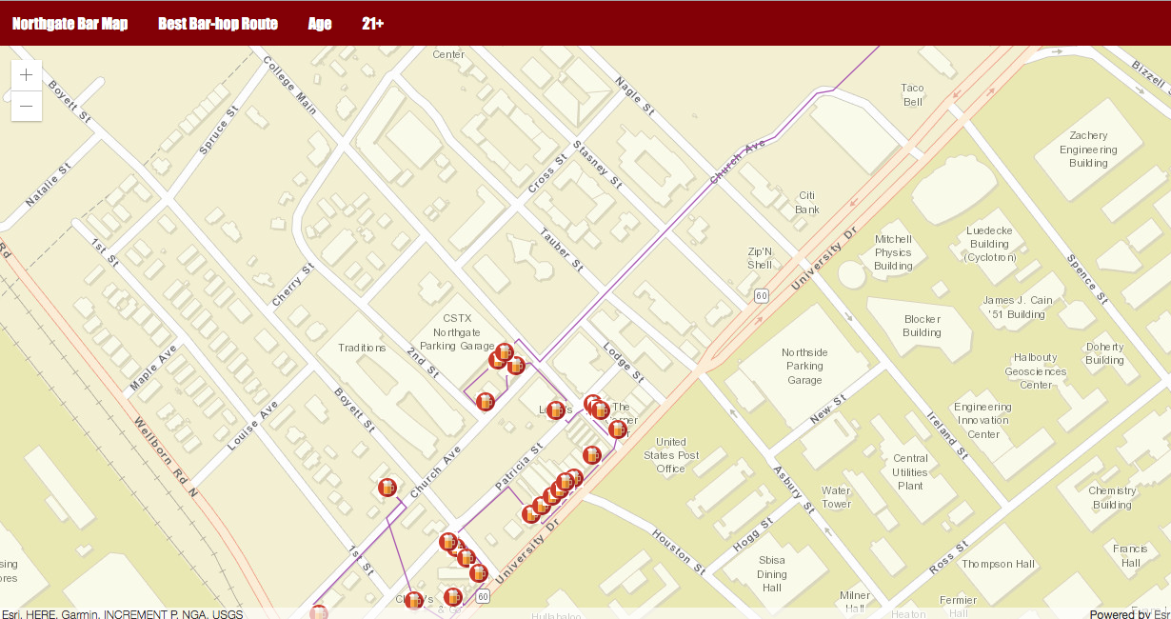
Goals
Create a map that contains viable bar hopping information for TAMU students.
Build a 2D basemap similar to AggieMap with clear and simple functions and efficient routes
Popup features: Bar name, age limit, drink specials,, hours of operation
2 different bar hopping routes (18-20 and 21+)

Slide 3
Motivation
AggieMap contains too many features and extensive layers that is not very user friendly.
Created to simplify AggieMaps into a version that helps TAMU students bar hop on Northgate.
Produce a straight forward, user-friendly map, that helps each age group (18-20 and 21+) drink at the best suited bars with the most efficient routes.

Slide 4
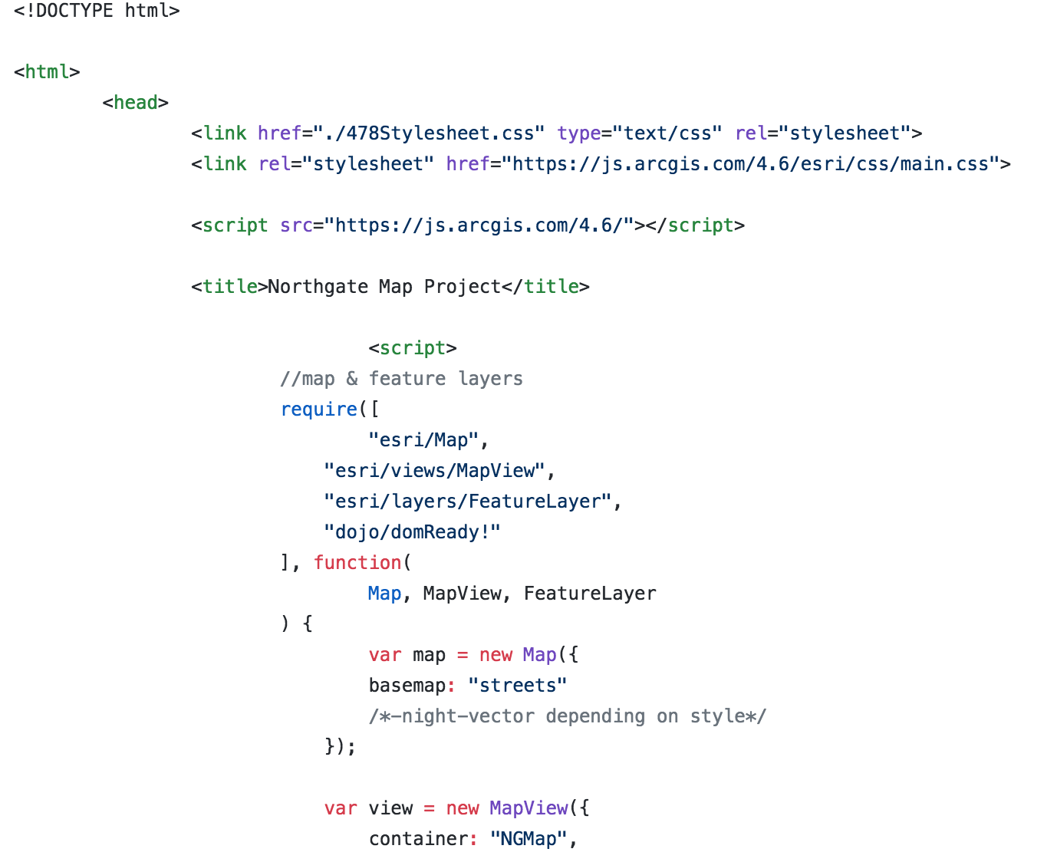
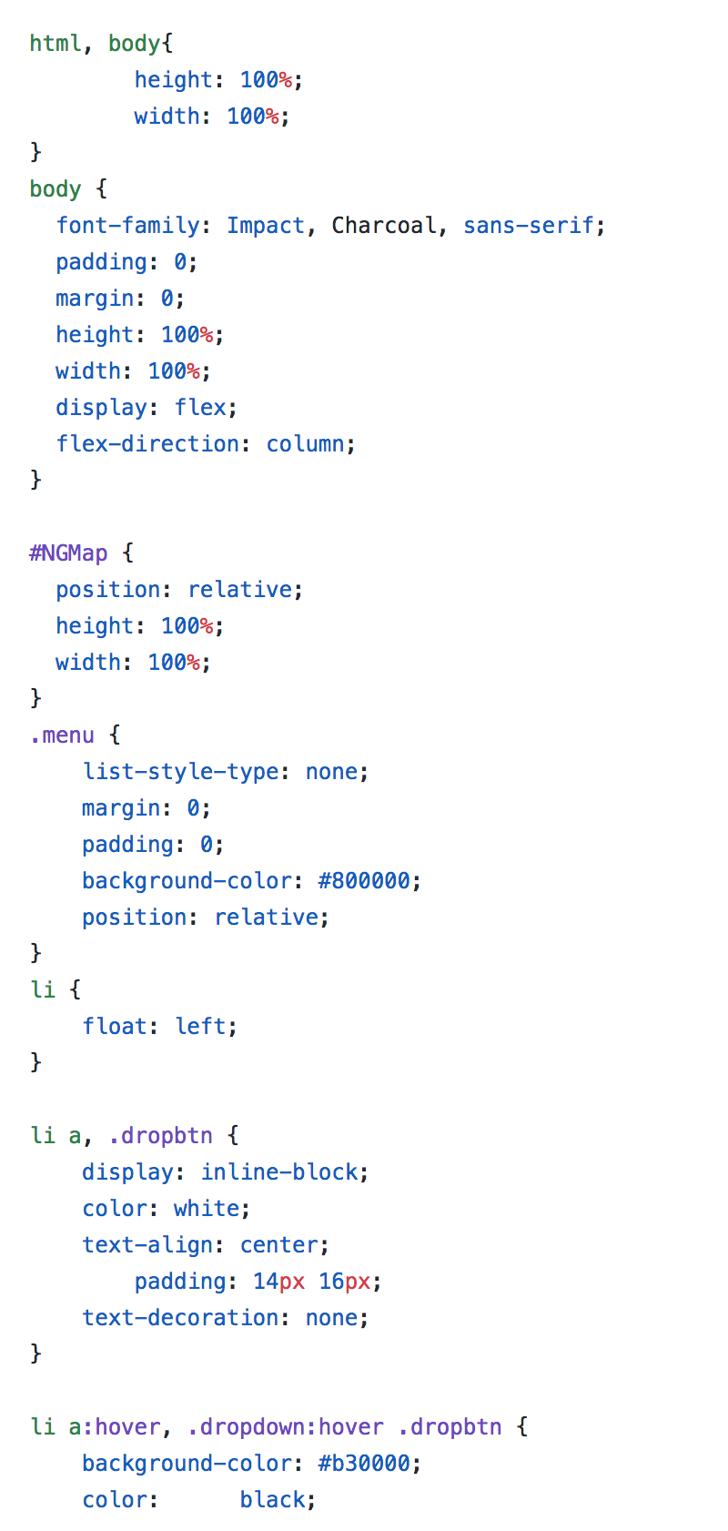
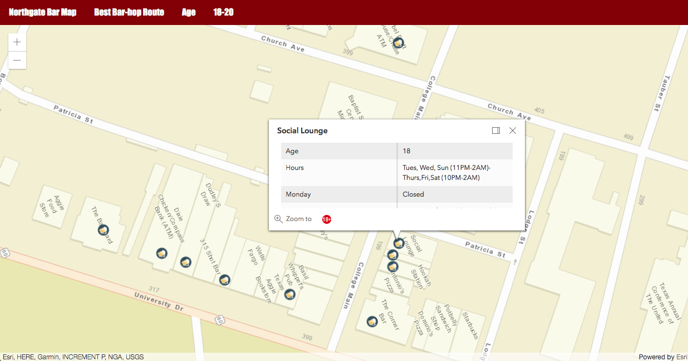
Approach
Project Design : 2D buildings, map features (toggle routes, switch between age groups, highlighted routes, interactive bar popups-name, age restrictions, drink specials, hours of operation.
Methods: HTML/JavaScript/CSS ArcMap, & ArcGIS Online
Data: Google spreadsheet containing the bar name, drink specials (Monday-Sunday), age restrictions, and hours of operation.
Duties: Kayla (Main data collector), Zach (Assistant data collector/ArcMap feature layer), Jimmy (programmer)

Slide 5
Results

Slide 6
Results

Slide 7
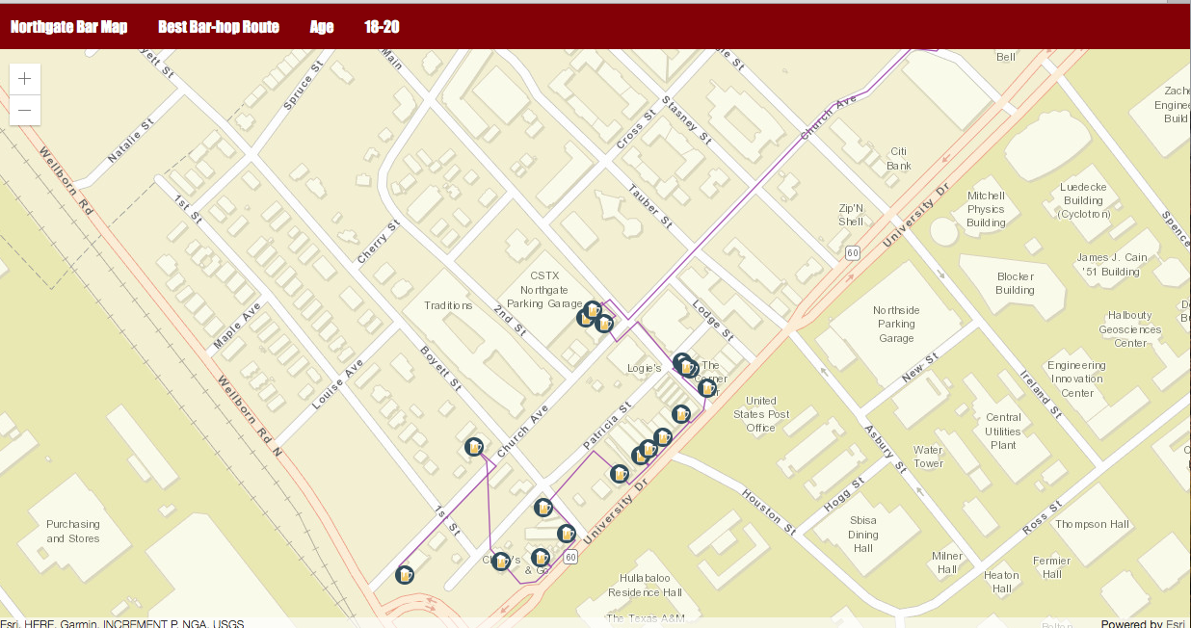
Results

Slide 8
Results
Working age buttons that hide/show bars you cannot/can go to due to age.
Bar hopping routes that hit every bar in the most efficient way.
Interactive popups:
Bar Name
Age
Hours
Drink Specials in relation to days of the week
https://github.tamu.edu/NORTHGATE/project

Slide 9
Discussion
GOAL: create a northgate map detailing bar specials, hours, and age requirements. It will contain interactive popup routes through the bars in the most efficient manner, and have the ability to specify your age to show you the best bars.
Originally set out to include bathrooms, but after consideration we figured that would be too complicated and interfere with our goal of creating a simple, easy to use map.
Accomplished all of our goals.
collecting data from each bar was much harder/took longer than expected

